Slide 1

AI Checker : Classic Checkers game with an
intelligent
prepared by: Jenish Patel (21BEIT30084)
Vishal Prajapati(21BEIT30111)
IT DEPARTMENT | LDRP-ITR | GANDHINAGAR

Slide 2


Introduction
English Checkers, or Draughts, is a timeless board game requiring strategic thinking and foresight. With AI integration, the game reaches new heights, offering players dynamic challenges and invaluable insights into decision-making processes.

Slide 3


Game Design
English Checkers features an 8x8 checkered grid where pieces move diagonally forward, capturing by jumping over opponent's pieces. Kinging occurs when a piece reaches the opposite end, enhancing strategic depth.

Slide 4


Basic Checkers Rules
Setup : Start with 12 checkers each, on dark squares. Players sit so dark squares are on their right.
Movement : Move checkers diagonally forward to empty dark squares. Kings move diagonally backward.
Capturing : Jump over opponent's checker to capture, if there's an empty space beyond.
Winning : Capture all opponent's checkers or block their moves to win. Strategic planning is vital.

Slide 5
AI in Checkers
"AI in checker game utilizes advanced algorithms like Minimax or Alpha-Beta Pruning to analyze potential moves and make strategic decisions. Heuristic evaluation functions assign scores to game states, guiding the AI towards optimal gameplay and providing players with a challenging opponent."

Slide 6

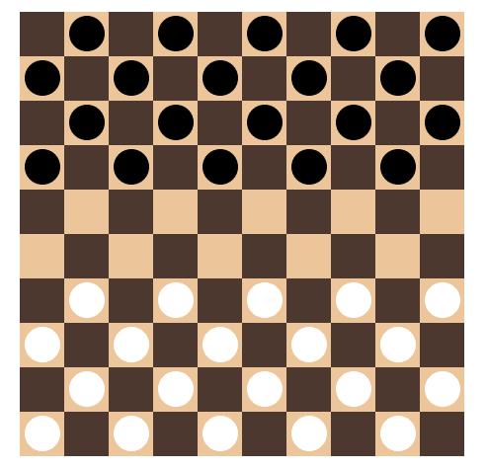
User Interface (UI)
Intuitive design with features like piece selection, displaying valid moves, and clear indication of AI's moves for seamless interaction.

Slide 7

"Checker Game: Enhancing Cognitive Skills and Knowledge"
Checkers game improves cognitive skills like critical thinking, problem-solving, and strategic planning . It enhances decision-making abilities , pattern recognition , and fosters patience and perseverance, making it a valuable tool for mental stimulation and growth.

Slide 8


Challenges and Considerations
"Challenges in implementing AI for English Checkers include search depth limitations and optimizing performance. Balancing game speed and difﬁculty is crucial.
Techniques like iterative deepening and move ordering can address these challenges."

Slide 9

Conclusion
English Checkers with opportunities. Embracing
AI offers AI
strategic
gameplay
and learning
creating
enriches
gaming
experiences,
dynamic challenges.

Slide 10
Thanks!
Do you have any questions?

